Slide 1
GAN: Generative Adversarial Network
Rowel Atienza
rowel@eee.upd.edu.ph
University of the Philippines

Slide 2
Why generative models?
Represent and manipulate high-dimensional probability distributions
Can be incorporated in Reinforcement Learning
In model-based RL, we can use GM to predict future rewards
GM can be trained with missing data
In semi-supervised learning, many training samples are unlabeled
Generation of realistic samples
Image super resolution
Art work synthesis
Image to image translation
Cross-domain transfer
Inpainting

Slide 3
Generative Models Landscape
GAN
VAE: Variational AutoEncoders
Autoregressive Models (PixelRNN, PixelCNN)
Generative Models

Slide 4
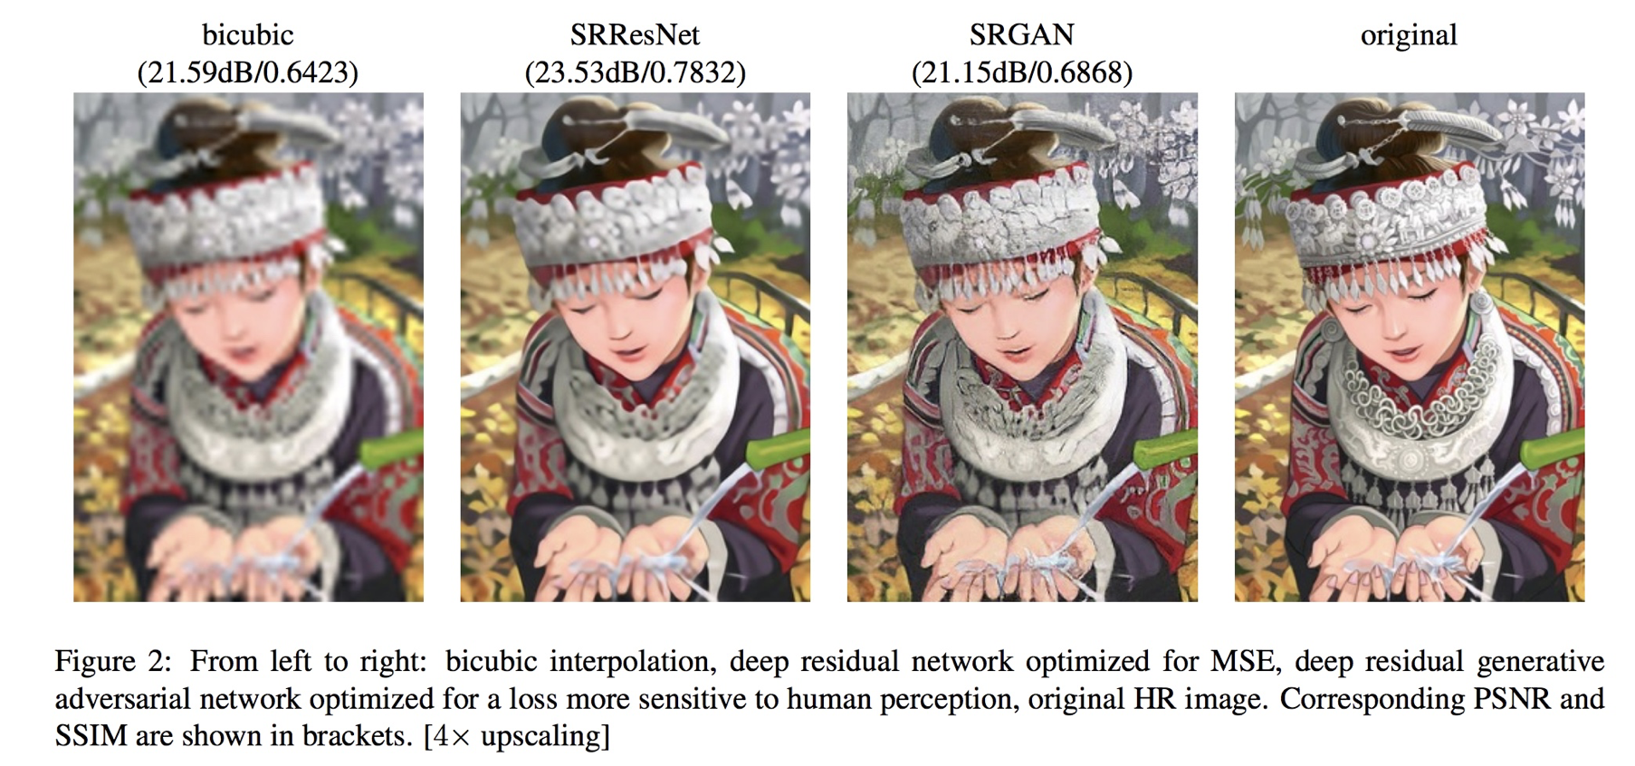
Image Super Resolution (SRGAN) [Ledig et al 2017]

Slide 5

ProGANSR
[Wang et al 2018]

Slide 6
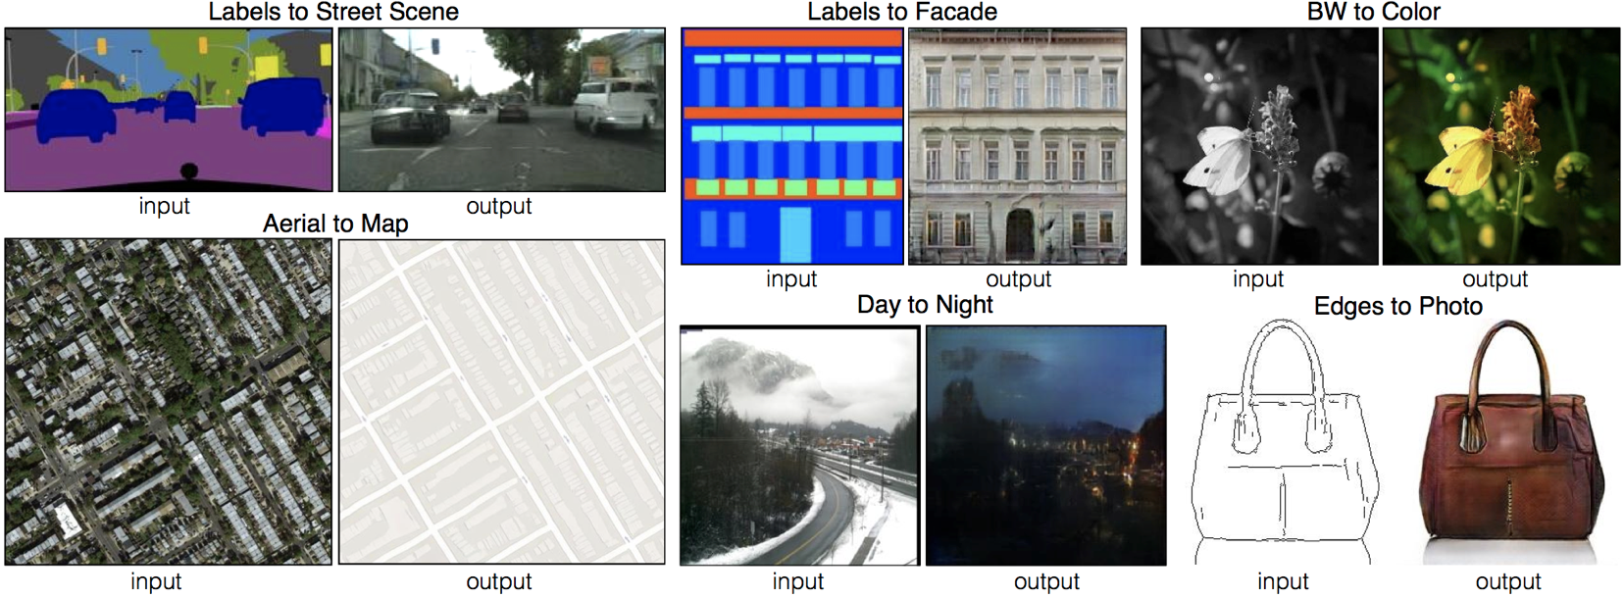
Image to Image Pix2Pix [Isola et al 2016]

Slide 7
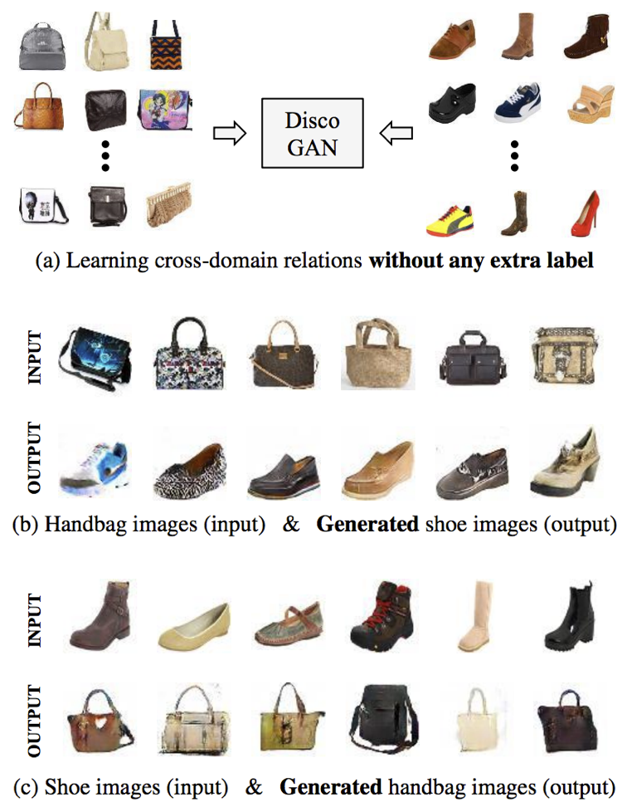
Cross-domain transfer (DiscoGAN)
[Kim et al 2017]

Slide 8
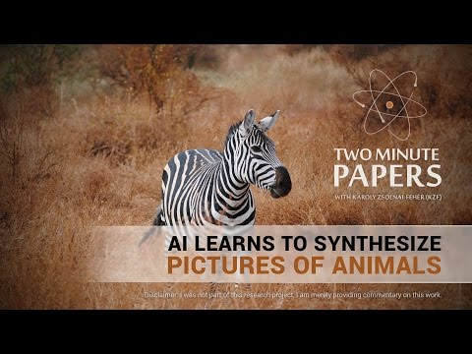
CycleGAN Zhu et al 2017

Slide 9
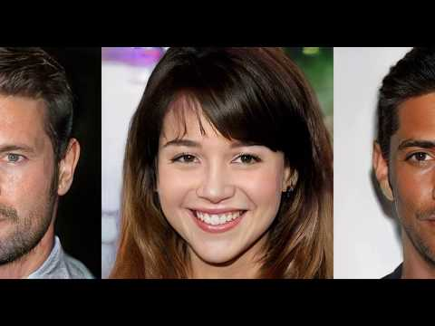
Progressive Growing of GANs [Karras et al 2018]

Slide 10
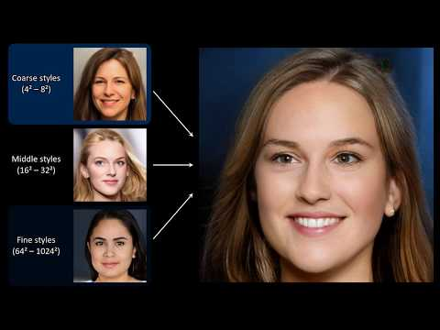
StyleGAN [Karras et al 2019]

Slide 11
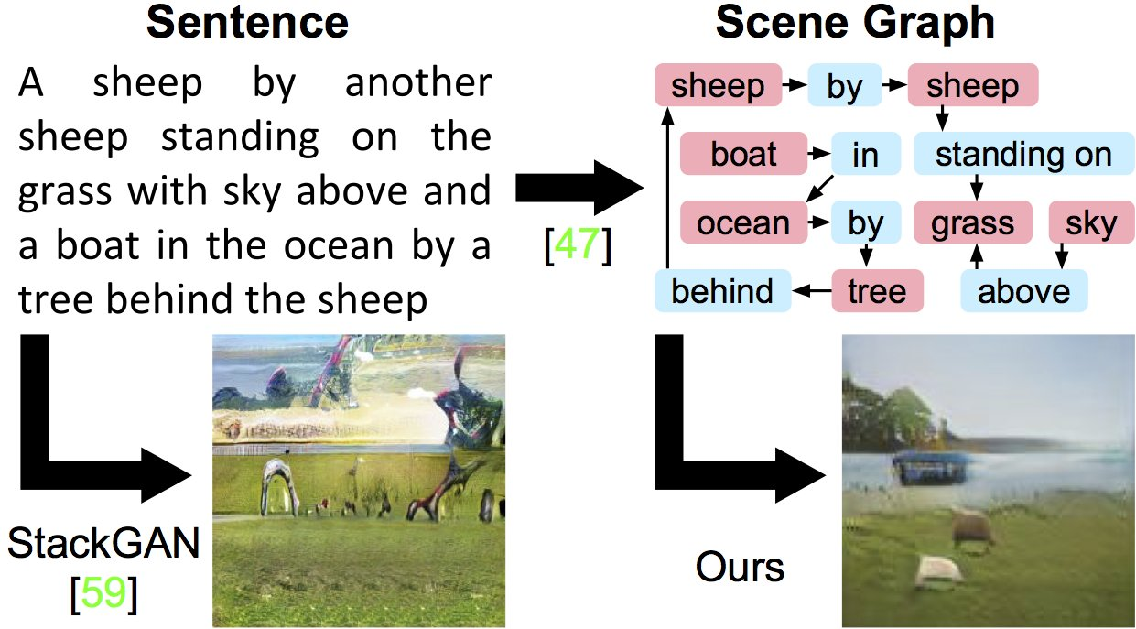
Image Generation [Johnson etal 2018]

Slide 12
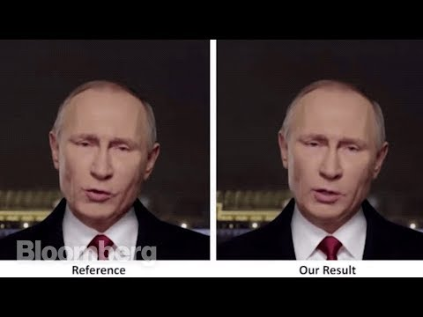
DeepFakes

Slide 13
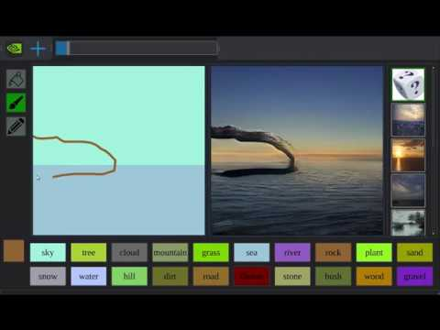
DeepFakes

Slide 14
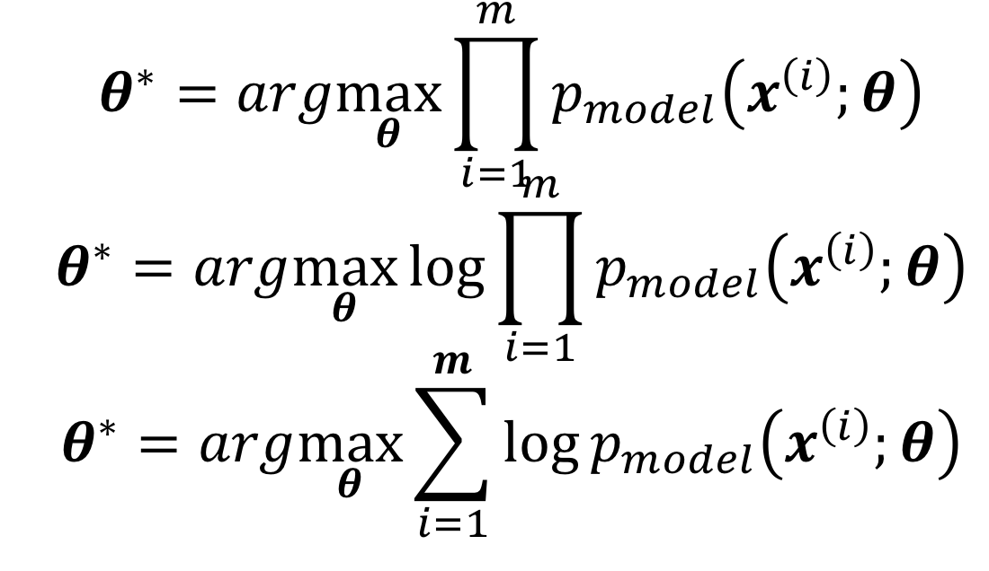
Maximum Likelihood Estimation (Basis of GAN)
Find a model parameterized by 𝜽 that estimates the input distribution

Slide 15
GAN - Maximum Likelihood Estimation
GAN aims to approximate the true data distribution from samples

Slide 16
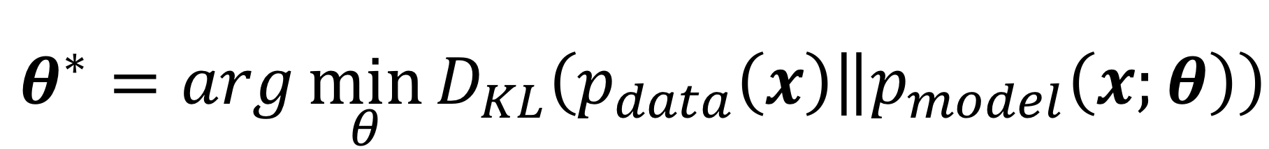
MLE is minimizing KL Divergence
If 𝑝_{𝑑𝑎𝑡𝑎}(𝒙) lies within 𝑝_{𝑚𝑜𝑑𝑒𝑙}(𝒙;𝜽), the model will recover 𝑝_{𝑑𝑎𝑡𝑎}(𝒙)
In practice, we do have access to 𝑝_{𝑑𝑎𝑡𝑎}(𝒙); only to training 𝑚 samples from 𝑝_{𝑑𝑎𝑡𝑎}(𝒙)
Using 𝑚 samples, we approximate 𝑝_{𝑑𝑎𝑡𝑎}(𝒙) by 𝑝 ̂_{𝑑𝑎𝑡𝑎}(𝒙) - an empirical distribution
By minimizing the KL divergence between 𝑝 ̂_{𝑑𝑎𝑡𝑎}(𝒙) and 𝑝_{𝑚𝑜𝑑𝑒𝑙}(𝒙;𝜽) is equivalent to maximizing the log likelihood of training set

Slide 17
GAN Framework
Two player system:
Generator and Discriminator
Both functions are differentiable wrt inputs and parameters
Generator – creates samples that are intended to come from the training data
Fools the discriminator
Discriminator – examines samples to determine whether they are fake (0) or real (1)
Trained using traditional supervised learning

Slide 18
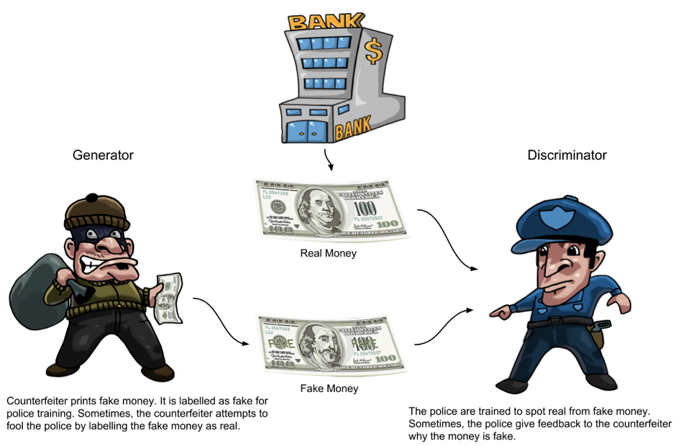
GAN Concept

Slide 19
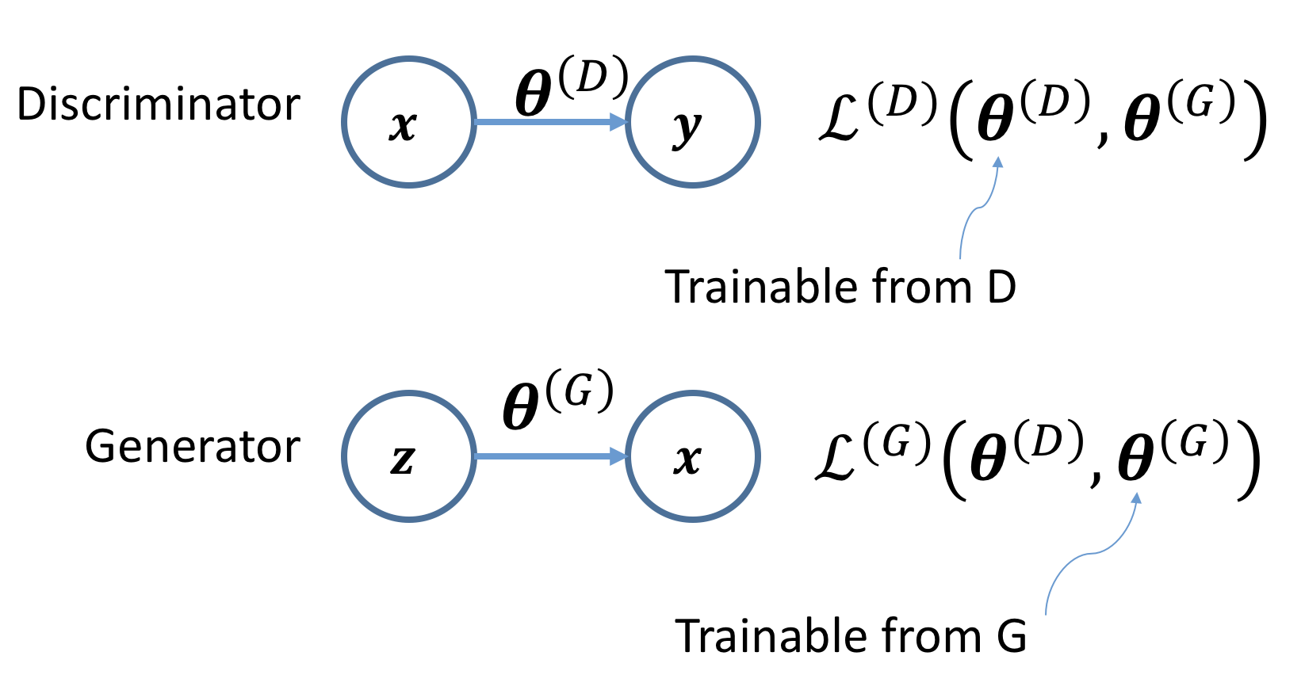
GAN Framework

Slide 20
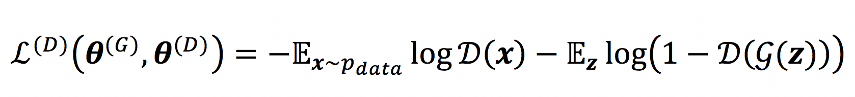
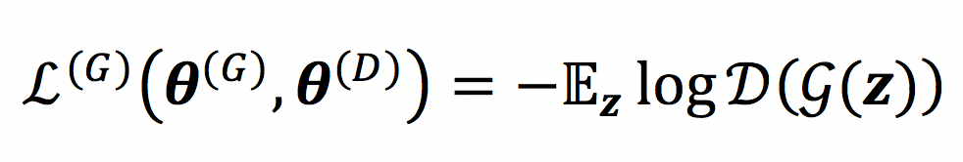
Loss Functions
Discriminator:
Generator:

Slide 21
Loss Functions - In English
Discriminator:
Learn to identify real (1) from fake (0)
Generator:
Learn to fool the discriminator by pretending to be real (1)

Slide 22
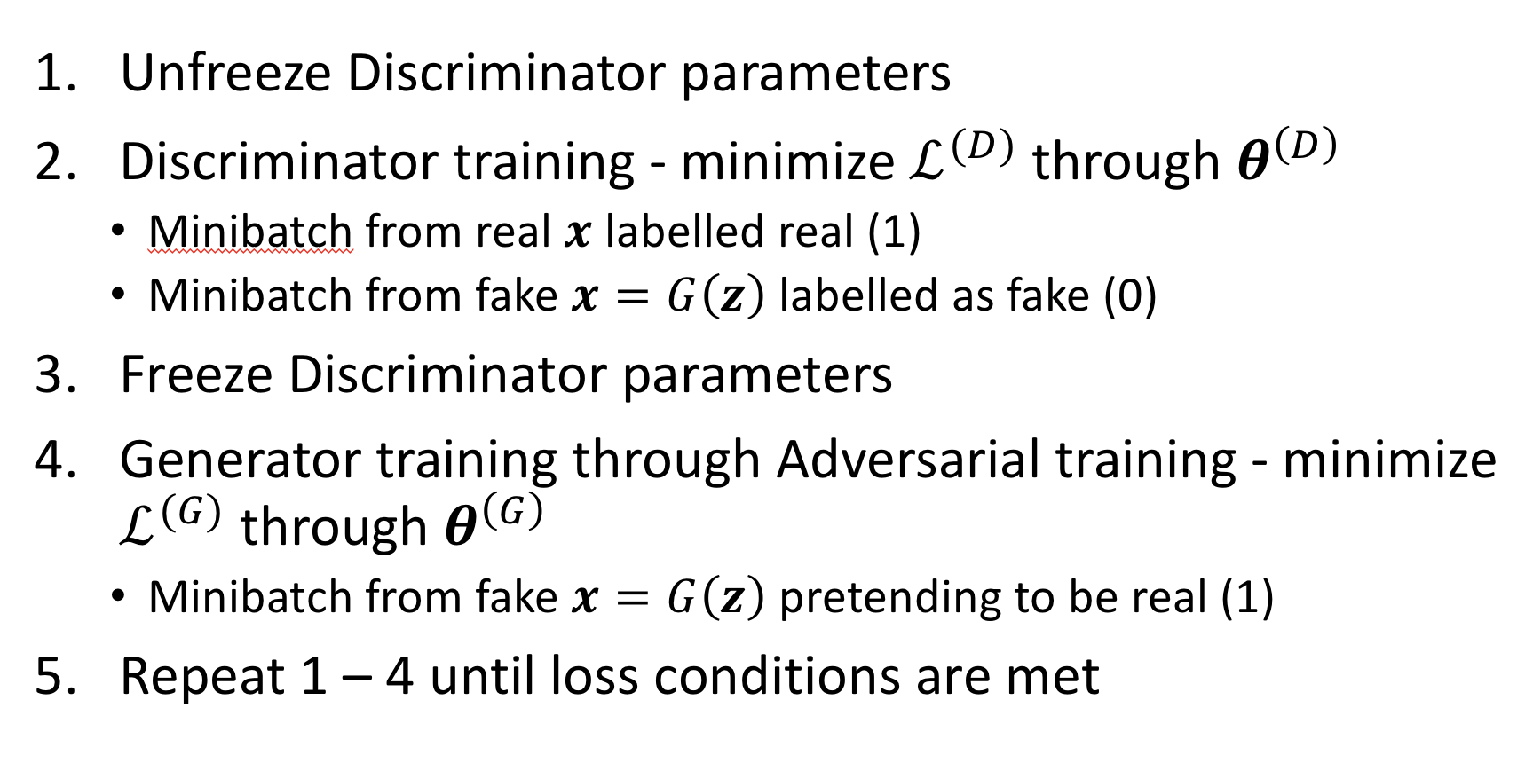
GAN Training

Slide 23
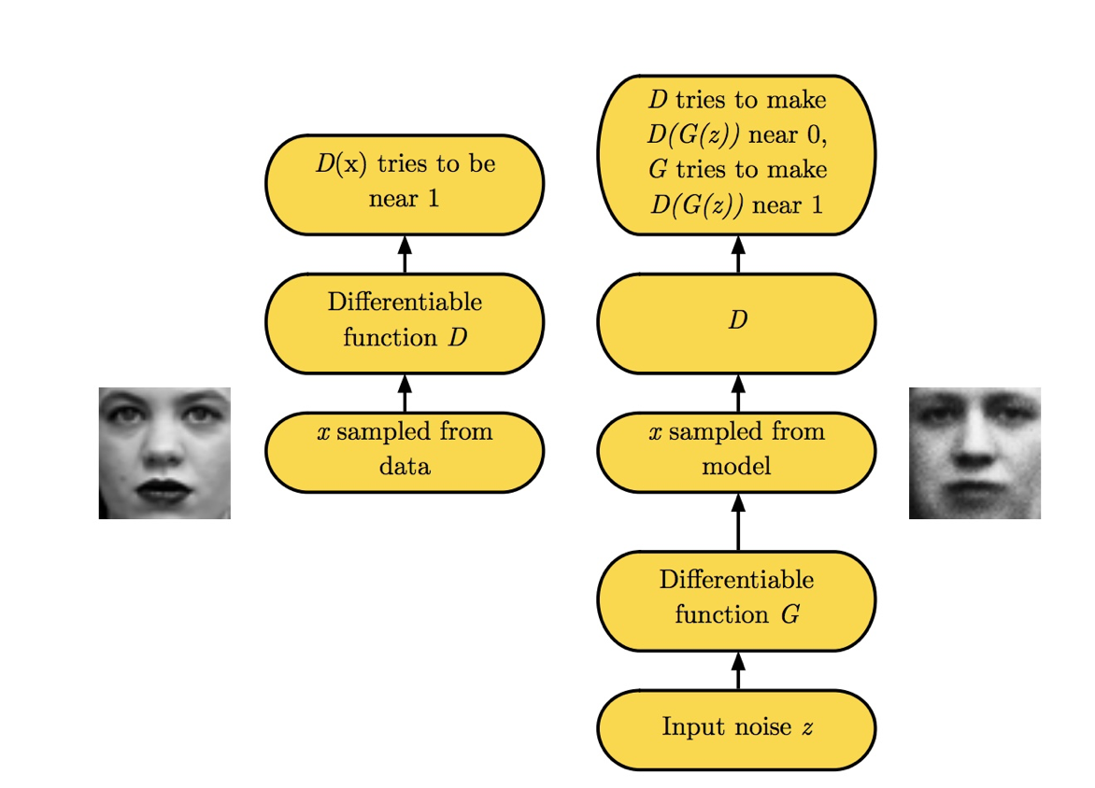
GAN Training [Goodfellow 2016]

Slide 24
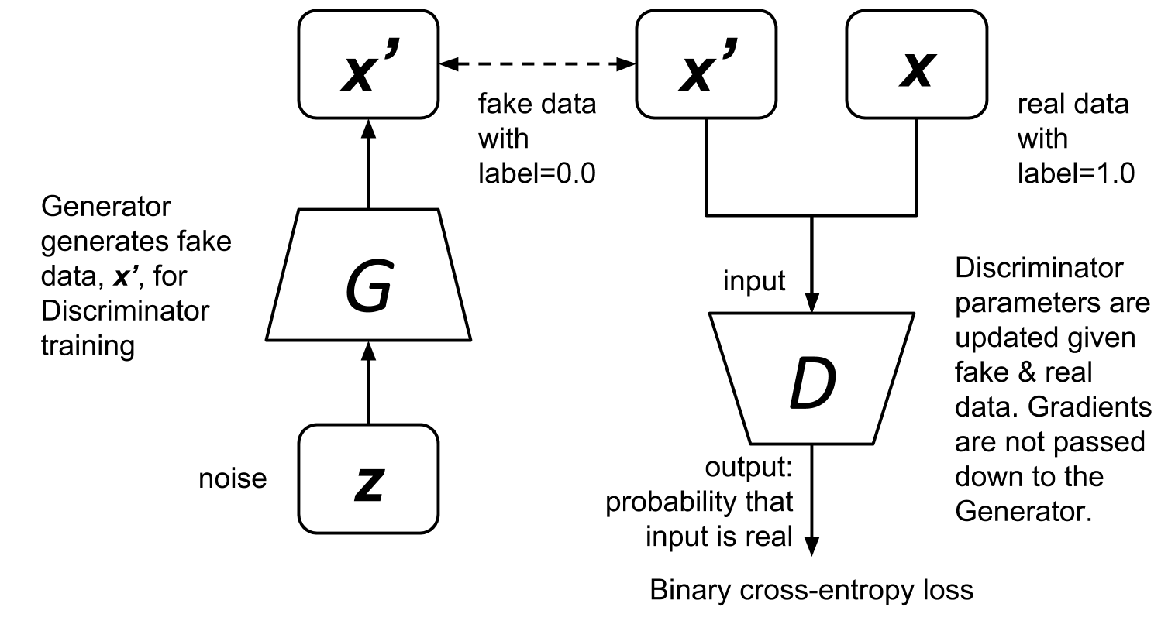
DCGAN Discriminator Training

Slide 25
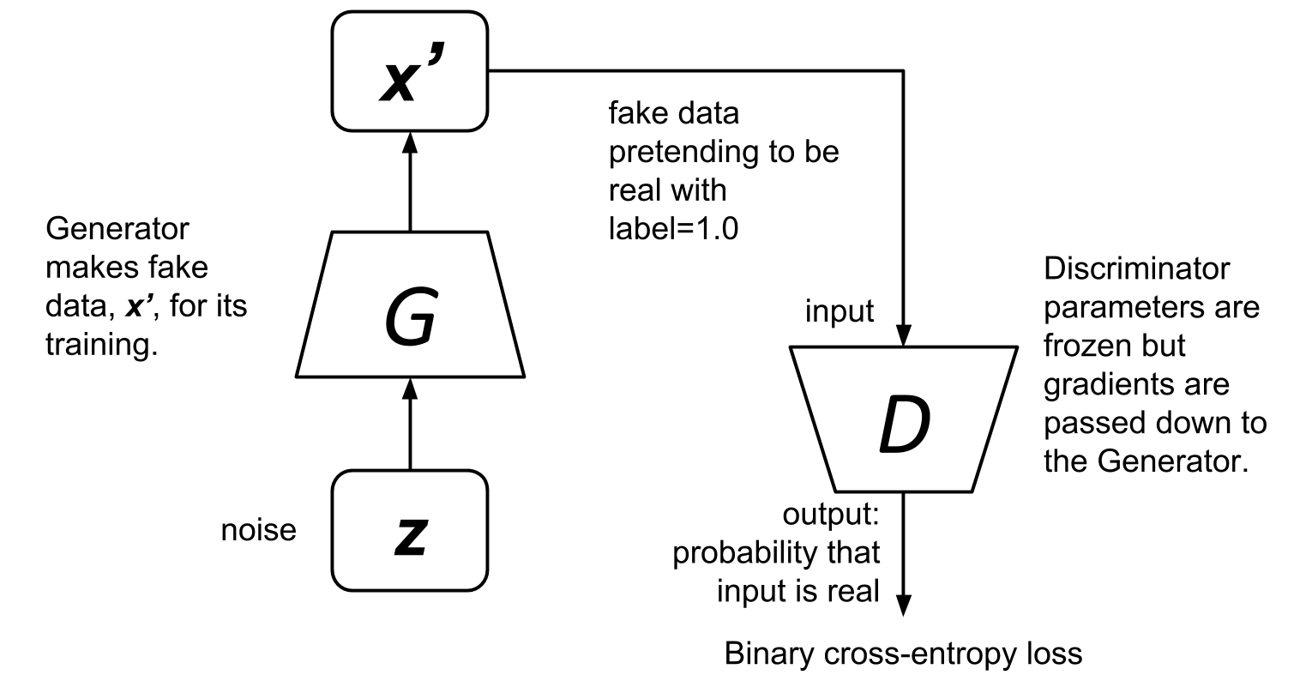
DCGAN Generator Training

Slide 26
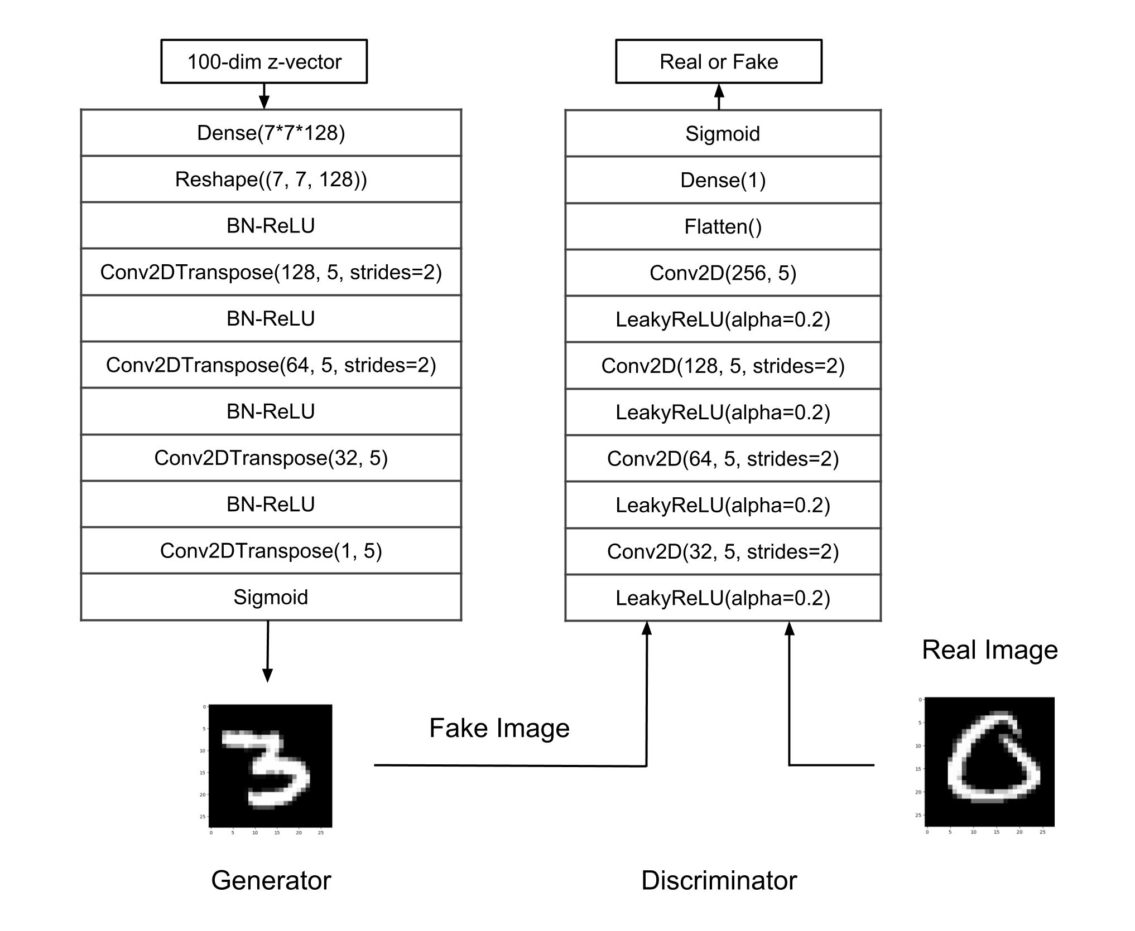
DCGAN [Radford 2016] in Keras
DCGAN is a GAN implementation using Deep CNN

Slide 27
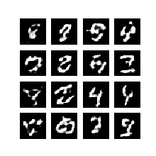
DCGAN Outputs

Slide 28
Conditional GAN [Mirza and Osindero 2014]
GAN has no control on which digits to generate from noise
CGAN - a variation of GAN that imposes a constraint (eg which digit) to control the attribute of the generator output

Slide 29
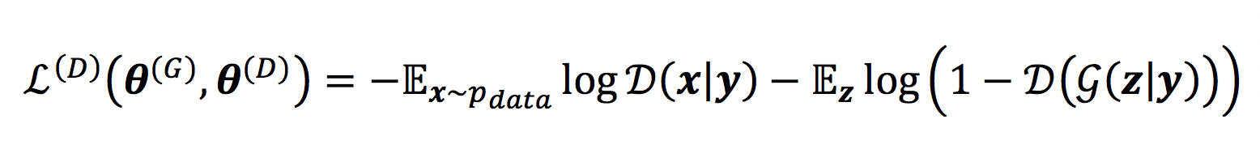
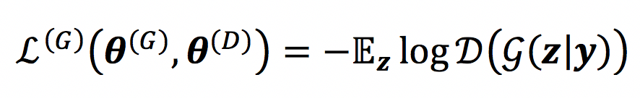
CGAN Loss Functions
Discriminator:
Generator:
Learn to identify real (1) given condition y from fake (0) given condition y
Learn to fool the discriminator by pretending to be real (1) given condition y

Slide 30
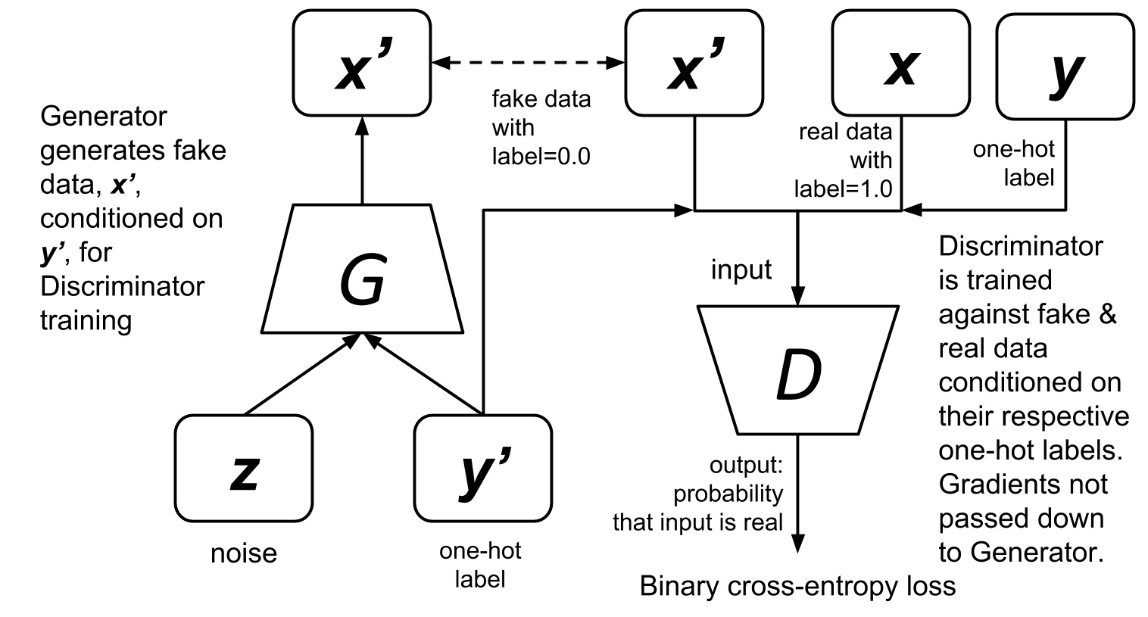
CGAN Discriminator Training

Slide 31
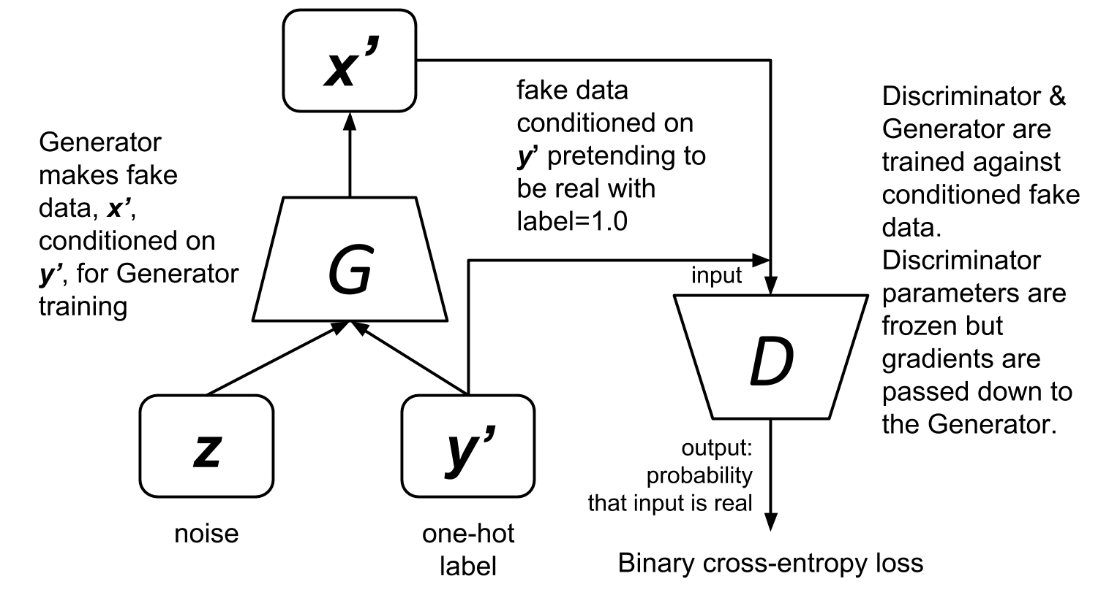
CGAN Generator Training

Slide 32
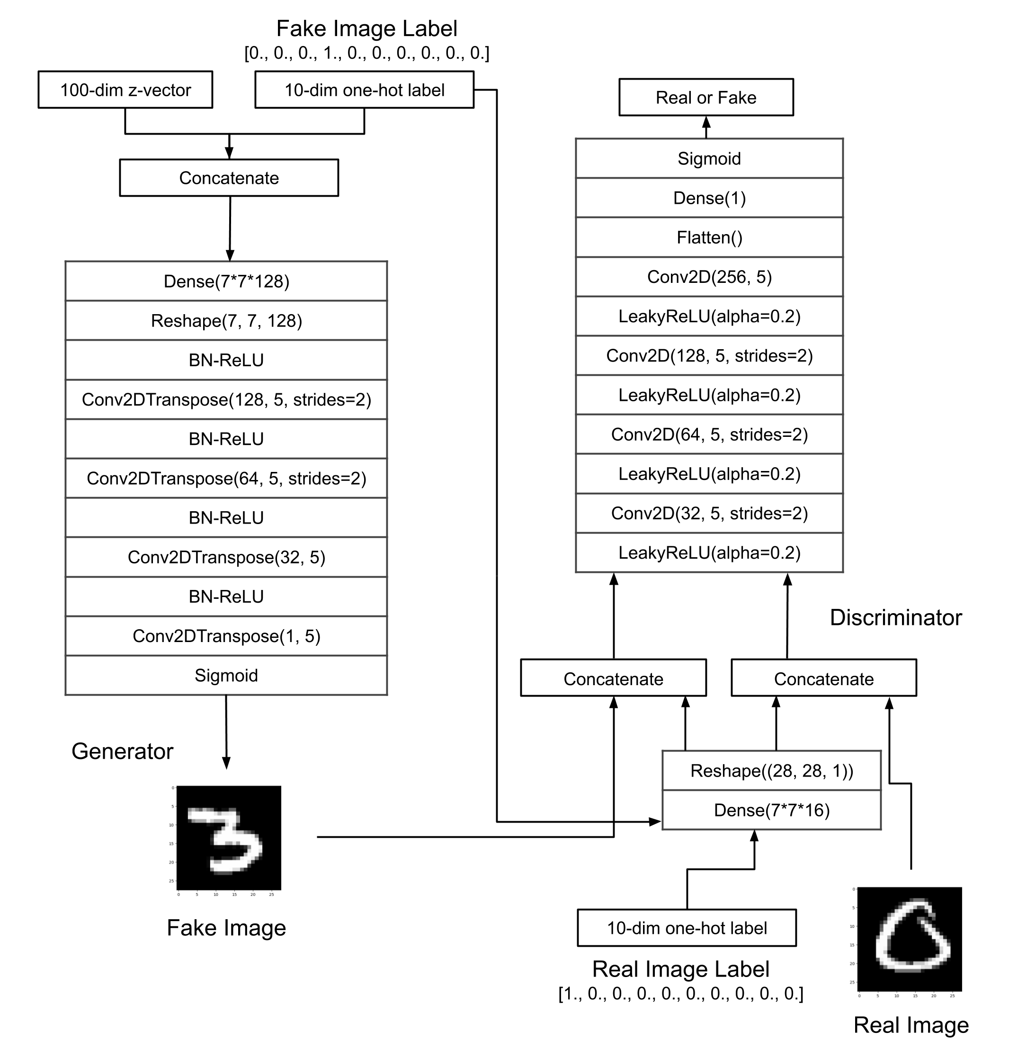
CGAN in Keras

Slide 33
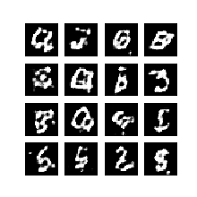
CGAN outputs conditioned to generate digits 0 to 9

Slide 34
References
Goodfellow, Ian. "NIPS 2016 tutorial: Generative adversarial networks." arXiv preprint arXiv:1701.00160 (2016).
Advanced Deep Learning with Keras by Rowel Atienza : http://a.co/d/e55mrQc

Slide 35
End

